Slide 1



Mitigating the effects of COVID-19 on Maternal and Child Health Services through differentiated ANC (DiffCOV)
Dr Dickens Onyango
Kisumu County Department of Health

Slide 2
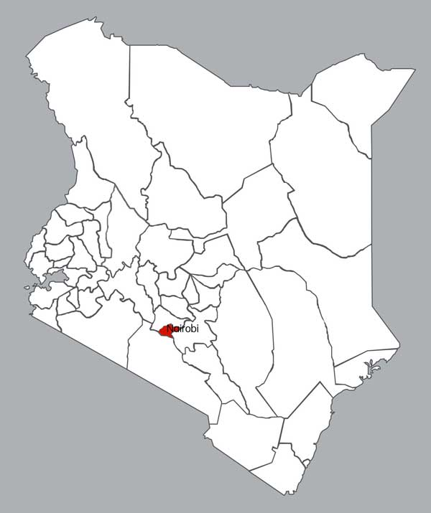
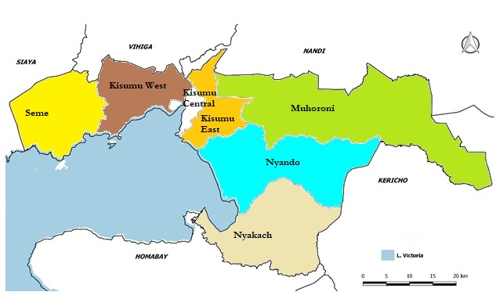
Background
Disruption of maternal, neonatal and child health services
Some facilities suspended routine MCH services,
Clients who visit the hospital are not attended to without masks
Fear of contracting COVID-19 in health facilities
Quality of ANC service: HCWs not palpating clients to avoid close contact with clients
Kenya
COVID 19 cases – 66,723 (12th Nov 2020)
Kisumu County
Population – 1.15 million people
Number of pregnancies – 48,550 annually
COVID 19 – 1507 (12th Nov 2020)

Slide 3
MOH guidelines for continuation of ANC services during COVID 19 pandemic
Clinic Visits
Client to call before visits
Minimize clinic visits to a max 4 face-to-face in routine care. Encourage tele-consultations
Antenatal Screening
All screening done at the first opportunity
Baseline investigations for co-morbidities
Patient Education
Extensive education on danger signs and IBP
Inform client/family the emergency contact and how to access care
Provide long-term refills for medicine and supplements
Strictly keep client contacts, both physical and virtual
Recommended routine lab investigations
Ultra-sound as per existing recommendations
Encourage non-accompanied visits where possible
Suspected or confirmed COVID-19 clients managed at isolation or treatment centres

Slide 4
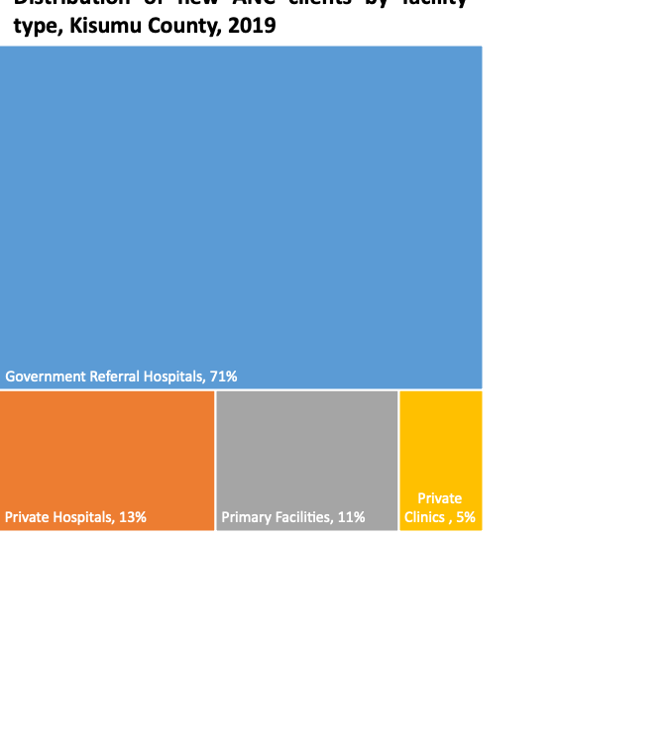
Poor uptake of ANC in primary facilities
Gap in availability of laboratory services
Health Care Levels | Number of Health Facilities | Number of Diagnostic sites | Laboratory Coverage (%)
Dispensaries | 47 | 24 | 51%
Health centers | 61 | 12 | 20%
County hospitals | 21 | 21 | 100%
Human resources for health
Cadres | In post | Required | Variance | %Variance
Doctors | 194 | 250 | 56 | -22%
Nursing Officers | 808 | 4269 | 3461 | -81%
Medical Laboratory officers | 117 | 522 | 405 | -78%
Clinical Officers | 183 | 361 | 178 | 49%
Radiographer | 14 | 30 | 16 | 53%

Slide 5
DiffCov Objectives
To evaluate the impact of a package of ANC interventions which are differentiated based on pregnancy risk-stratification on pregnancy outcomes among pregnant women attending ANC in Kisumu county
To mitigate disruption to ANC services by introducing point of care (POC) laboratory diagnostic testing in primary health facilities and using CHWs and telemedicine to provide community-based ANC services
To measure the reach, effectiveness, adoption, implementation and maintenance of the differentiated ANC package using the RE-AIM framework
To assess the incremental cost of differentiated ANC package and the incremental cost-effectiveness of this package as compared to the standard of care (facility-based care)

Slide 6
Study populations and inclusion criteria
Study population: All pregnant women attending ANC in 25 sites
Inclusion Criteria
Exclusion criteria
Pregnant women of all ages attending ANC in intervention sites who consents
Gestation age < 30 weeks
Pregnant women of all age attending ANC in intervention sites who declines to provide consent
Gestation age ≥ 30 weeks
Pregnant women who are not permanent residents in the study area or intend to relocate from the study area

Slide 7


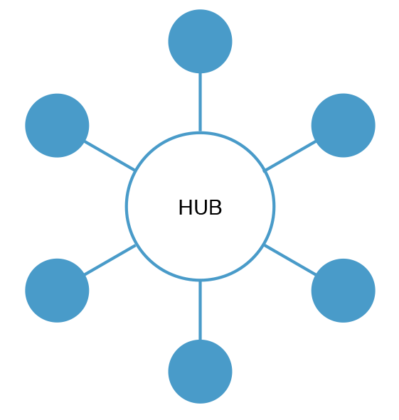
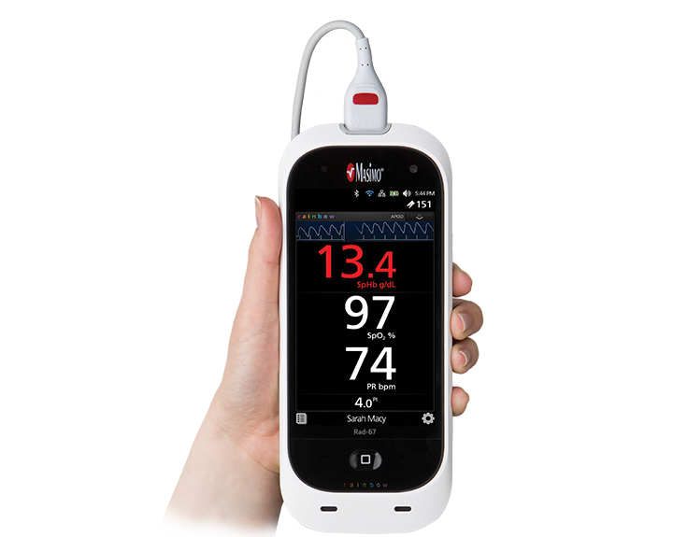
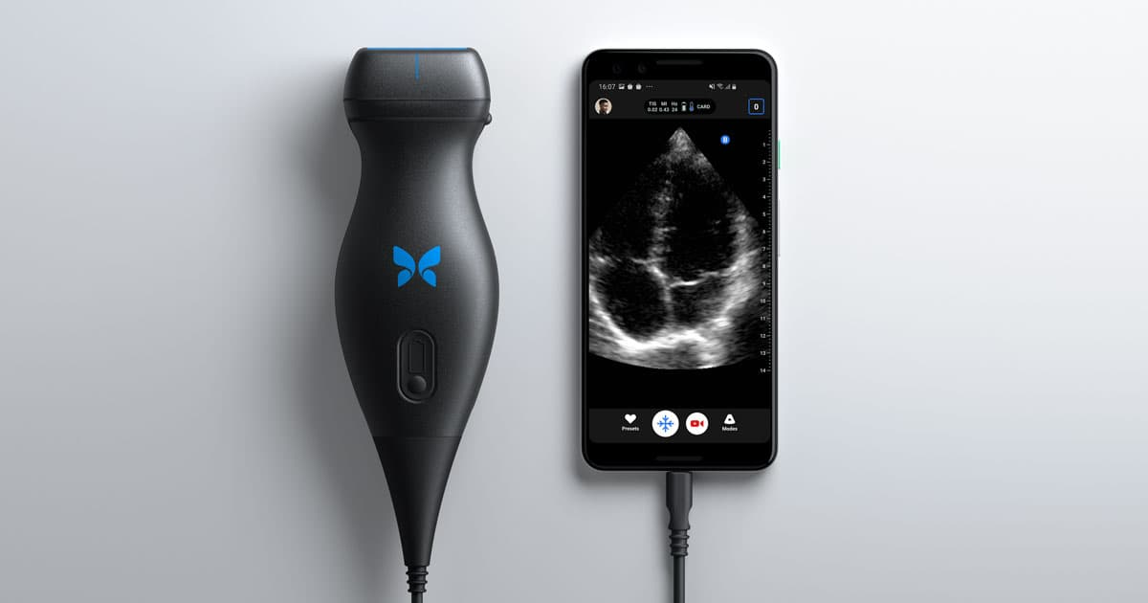


Proposed DiffCov interventions
ANC schedule differentiated based on risk
Facilities organized into hub and spoke
POC devices for lab tests in spokes e.g Masimo Rad-67
Pregnancy risk scoring
Remote care through telemedicine
Butterfly ultrasound
Collect data on client experiences
Electronic medical registers

Slide 8
Pregnancy risk stratification
Risk score – adapted from available ones (Vital Pakistan)
Variables included:
  Pre-existing conditions
  Type of gestation – singleton vs multiple
  Maternal age
  Socio-economic factors
Categories - low-, medium- and high-risk groups
Computerized decision support tool via smart phones
Categorizations reviewed at each ANC contact

Slide 9
Differentiated ANC package
Four facility based ANC visits
  At 1st contact, 30, 36 and 40 weeks
Four community based ANC visits
  At 20,26, 34 and 38 weeks
  Provided by CHWs, CHEWS with support from a HCP
  Measurements and assessments transmitted real time through a digital platform
Individual birth plans
PNC and early childhood interventions up to 7 days post-partum

Slide 10

Remote care and telemedicine platform
A clinic-facing practitioner module:- medical records
A CHW / mobile-facing module:
A patient module:
  Clients view their data and track their progress through pregnancy
A mobile phone text-messaging platform:
  Two-way communication between pregnant women and their health facilities
  Reminders: clinic appointments, taking medication, assessment of foetal movements and probing for danger signs

Slide 11
RE-AIM Framework to assess scalability
Component | Assessment | Measure
Reach | Number of pregnant women willing to participate in differentiated ANC care/all pregnant mothers offered differentiated ANC care | Factors influencing acceptability of differentiated ANC care among pregnant women, their partners and the clinicians
Effectiveness | Additionality of differentiated ANC on access to WHO recommended interventions | Measured in clinical outcomes above
Adoption | Proportion of pregnant who actually participate in differentiated ANC care and how this varies by sites, sub-county and ANC services | Barriers and facilitators of adopting differentiated ANC care
Implementation | Fidelity of differentiated ANC care and the Quality of ANC services /coverage of key ANC interventions/ANC clients compliance to ANC visit schedule/costs of differentiated ANC | Pregnant women and clinician experiences with implementation of differentiated ANC care
Maintenance | Consistency in implementation of differentiated ANC care over the 1 year period of implementation | Pregnant women and clinicians adherence to differentiated ANC care over time and barriers and facilitators of consistent implementation.

Slide 12
Thank You

