Slide 1

Antenatal, Intrapartum and Postnatal Care COVID-19 Surveillance Study
Victor Akelo
Dickens Onyango

Slide 2
Evolution from CHAMPS & ARC
ARC
CHAMPS
Child mortality surveillance
MNH HH surveillance
MNH Study
AnCov
DiffCov
Pregnancy surveillance

Slide 3
Background information
Coronavirus Disease 2019 (COVID-19) - as of 4th August 2020
  18.4 million infections, 692,000 deaths globally
  23,202 infections, 388 deaths in Kenya
SARS‐CoV‐1 2002/2003 –
  Maternal - high maternal mortality (CFR-25%)
  Foetal - spontaneous abortions, IUGR
Review of articles reporting COVID-19 :
  108 COVID-19 –infected pregnant women
  High caesarean section rates due to foetal distress – 92%
  Few adverse perinatal outcomes
Kenya – COVID-19 burden in pregnancy unknown
  One maternal death – Oyugis sub-county hosp
Possibility of vertical transmission - uncertain

Slide 4
Objectives
Primary
  Estimate the burden of COVID-19 in pregnancy, new-borns and children
  Evaluate the impact of COVID-19 infection on pregnancy outcomes
Secondary
  Assess impact of pre-existing conditions on COVID-19 in pregnancy
  Assess the risk of vertical transmission from mother to child
  Document the link between HIV and COVID-19 in pregnancy
  Determine impact of COVID-19 on mortality (perinatal, neonatal, maternal)
  Evaluate the role of new tools – ultrasound

Slide 5
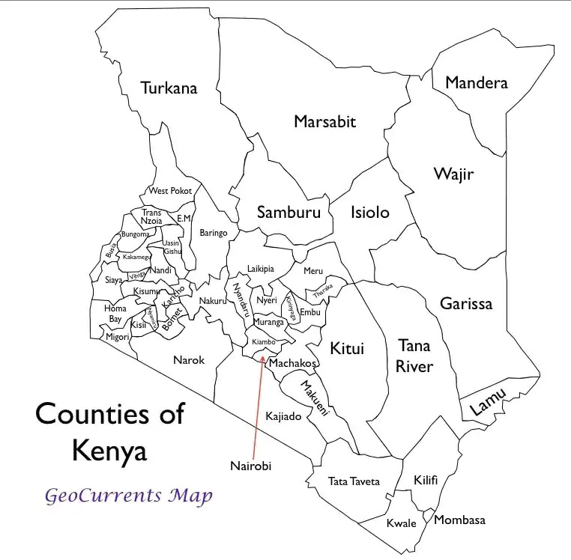

Study sites
Primary sites - CHAMPS/ARC sites ANC Health facilities
  COVID-19 isolation centres (JOOTRH/KCRH/Siaya CRH, Bondo)
  Community – HDSS (Manyatta & Karemo)
Expansion
  COOVID-19 isolation centers in Busia, Kakamega, Homa Bay, Tabitha clinic in Nairobi

Slide 6
Study Design
Prospective cohort
  Enrol pregnant mothers with (un)known COVID-19 status (facilities&community)
  Enrolment - symptomatic screening & COVID-19 testing; within 2 hours
  Follow up – through pregnancy (8 ANC contacts) until 12 months post partum
  Each ANC visit - symptomatic screening & COVID-19 testing
  Newborns - COVID-19 testing
COVID-19 testing – PCR/serology
Outcomes - miscarriage, stillbirth, maternal/neonatal death death
Collaboration with ARC – transition of mothers

Slide 7
Study population
All pregnant mothers attending ANC in participating facilities
  Includes those who are not HDSS residents
  Pregnant mothers aged <18 years - eligible
  Inclusion criteria – informed consent
Eligible populations
  Manyatta – 1,000 pregnant women
  Karemo – 2,000 pregnant women
Desired sample size
  2,500 pregnant women

Slide 8
Surveillance strategies
Health facility surveillance
Community surveillance
COVID-19 isolation centers
ANC clinics/maternities/PNC/wards of participating facilities
Daily – screen all women visiting facility for eligibility
Review ANC/PNC registers
Line list all pregnant/PNC women
Facility CHWs – identify eligible women from their catchment pop
CHWs – identify pregnancies in their 100 HHs
HDSS CIs - identify pregnancies during rounds
Notify study team – realtime (SMS/call)
Refer pregnant women to facilities for COVID-19 screening/testing
Target – report pregnancies within 24 hrs

Slide 9
Eligibility screening tool
A. | Eligibility Confirmation
 | Screening ID:
 | |___|___|___|___|___|___|___|___|
 | Screening Date:
 | |___|___| - |___|___| - |___|___|___|___| (dd-mm-yyyy)
 | Screening Location
 | ⃝ ANC Facility→ specify facility:_______________________ ⃝ Participant’s home→ Collect GPS coordinates ⃝ Other location → specify:___________________________
 | Has pregnancy been confirmed?
 | ⃝ Yes → specify confirmation method:_____________________ ⃝ No → Refer the mother for pregnancy screening and confirmation (She may be rescreened if pregnancy is confirmed)
 | Does mother currently reside in the study catchment area?
 | ⃝ Yes ⃝ No → Ineligible (Thank mother and STOP interview)
 | Has pregnancy been confirmed?
 | ⃝ Yes → specify confirmation method:_____________________ ⃝ No → Refer the mother for pregnancy screening and confirmation (She may be rescreened if pregnancy is confirmed)
 | Mother’s date of birth
 | Day: Month: Year: | |___|___| (enter 99 if unknown) |___|___| (enter 99 if unknown) |___|___|___|___| (enter 9999 if unknown)
a. | If mother’s date of birth is unknown, estimate age in years
 | |___|___| years
 | Is maternal age ≥ 18 years (or legal age of consent per local regulations)?
 | ⃝ Yes ⃝ No → Ineligible (Thank mother and STOP interview)
 | If Q.4, 5, 6, and 8 = “Yes”, woman is eligible to participate. Proceed to consent.

Slide 10
Pregnancy screening tool

Slide 11
Data collection
Electronic - tangerine platform (RTI)
Notifications of pregnant women – USSD codes
Data storage – dedicated server
Integration with MOH-COVID-19 data systems – Jitenge, EMR, tracker
Daily sharing of positive cases with MOH
Integration with CIN
IPC – staff to observe strict IPC during interaction with clients
  Masking of staff and clients

Slide 12
Variables and measurements
Category | Maternal | Newborn/Fetal
Demograpic | Age, locator information
Obstetric measurements | Gestation age, parity, anthropometrics, BP | APGAR
Laboratory | HB, glucose, urinalysis
 | Syphilis, malaria, HIV testing
Ultrasound | Obstetric, lung
Interventions | IPT, IPTp, IFAS
Outcomes | Severe morbidity, DM, PET, mortality, abortions | Stillbirths, neonatal mortality, prematurity, low birth weight
COVID-19 testing | PCR, Serology (NP/OP swab) | PCR, Serology (NP/OP swab, newborn blood, umbilical blood, placenta)

Slide 13
Timing of measurements
Study visit | Specimen collected | Measurements/Tests to be conducted
Enrollment | Blood , Urine, NP/OP swab, Saliva, Sputum | Anthropometry, COVID 19 PCR and serology HIV, Syphilis, LFTS, Urea and electrolytes Urinalysis
Follow up ANC Visit (max 8) | Blood , NP/OP swab, Saliva, Sputum | Repeat HIV/syphilis, COVID 19 PCR and serology Anthropometry
Delivery | Maternal - NP/OP swab Fetal - NP/OP swab, Umbilical cord blood | Maternal - COVID 19 PCR and serology Fetal - Maternal - COVID 19 PCR and serology Birth weight Placental tissue testing for antibodies
First PNC visit | NP/OP swab, Saliva Sputum | Maternal - COVID 19 PCR and serology Infant - Maternal - COVID 19 PCR and serology Infant - Anthropometry
Follow up PNC visits | NP/OP swab, Saliva Sputum | Maternal - COVID 19 PCR and serology Infant - Maternal - COVID 19 PCR and serology Infant - Anthropometry
12 month visit | NP/OP swab, Saliva Sputum | Maternal - COVID 19 PCR and serology Infant - Maternal - COVID 19 PCR and serology Infant - Anthropometry

Slide 14
Ethical considerations
Ethical approval – KEMRI/JOOTRH/CDC
Screening for eligibility
Administration of informed consent
  Woman’s preferred language - English, Swahili, and Dholuo
  Explain purpose, procedures and investigations
  Allow woman to ask questions
  Women have right to decline participation or withdraw at any stage
  Women who decline or withdraw will continue to enjoy standard MOH ANC/PNC services

